Slide 1
Solar Eclipse

Slide 2
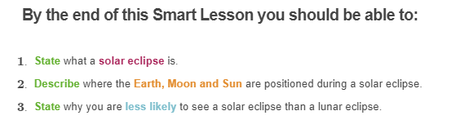

Slide 3
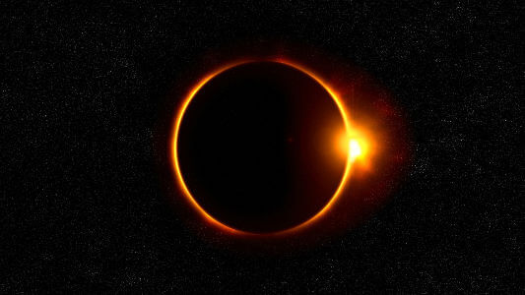
Solar eclipse
Remember that an eclipse is named after the object that is becoming darker, so a solar eclipse means that the Sun appears darker.

Slide 4
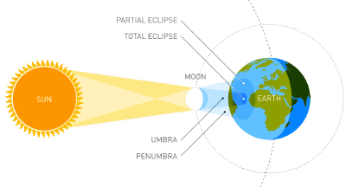
A solar eclipse happens when the Moon passes in front of the Earth, casting its shadow onto the Earth.
This blocks out the Sun's light, making the Sun appear darker.

Slide 5
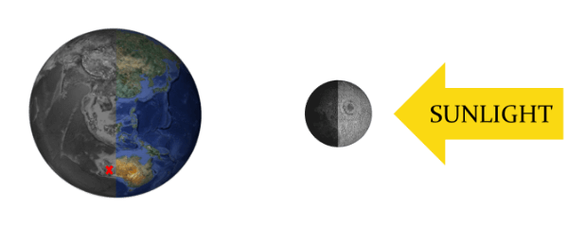
The Moon must be directly between the Sun and the Earth for a solar eclipse to occur, so they only happen when there is a new moon.
New moons occur when the Moon is between the Sun and Earth.

Slide 6
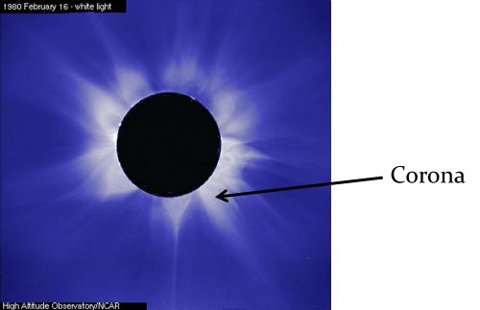
Scientists like solar eclipses because it makes it easier for them to study the sun.
When there is a total solar eclipse they can study the corona. The corona is the Sun's outer atmosphere.
The corona is visible during total eclipses of the Sun as a pearly white crown surrounding the Sun. The sun is usually too bright to see the corona, so this is the main time that it can be studied.

Slide 7
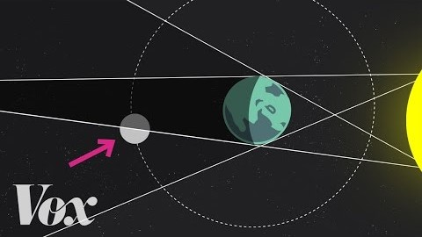

Slide 8
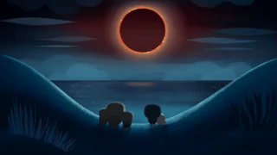
There are three different types of solar eclipse.
A total solar eclipse occurs when the Moon completely blocks the Sun. These are very rare because even though the Moon orbits the Earth once a month, it requires a very exact alignment between the Earth, Sun and Moon to create a solar eclipse.

Slide 9
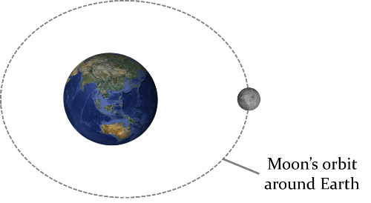
As well as the Moon's orbit being tilted in relation to the Earth's orbit, the Moon's orbit is slightly elliptical.
This means that at some points in its orbit it is closer to the Earth, and at some points it is further away. The distance between the Earth and the Moon varies by about 13% during its orbit.

Slide 10
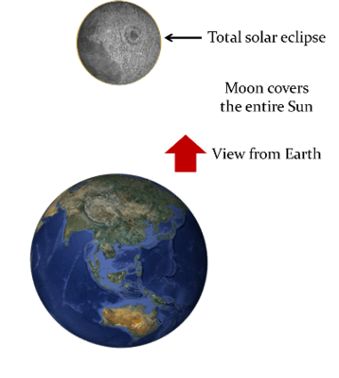
Total solar eclipses only occur when the Moon is close enough to the Earth for its shadow to block out the entire Sun.

Slide 11
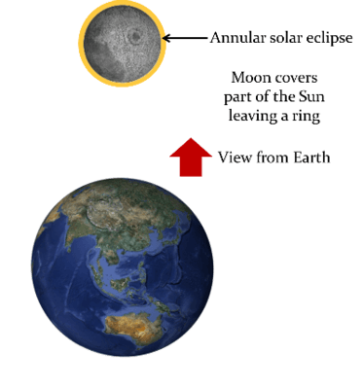
Annular solar eclipses occur when the Moon is further away from the Earth so only the centre of the Sun is blocked, leaving the outer ring visible.
"Annular" means "ring-shaped".

Slide 12
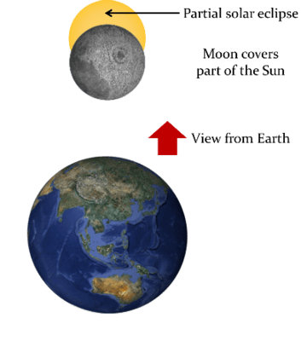
Partial solar eclipses occur when only part of the Sun is covered by the Moon.
They are more common than total solar eclipses because they require less exact alignment between the Earth, Moon and Sun.

Slide 13
The part of the Earth in the penumbral shadow of the Moon also observes a partial eclipse.
This means that during a total solar eclipse, some parts of Earth will see it as a partial solar eclipse.

Slide 14
To see a solar eclipse, you must be in the path of the Moon's shadow when the Moon passes between the Sun and the Earth.
Since the Earth is so large compared to the Moon, the Moon's shadow only falls on a small part of the Earth.

Slide 15
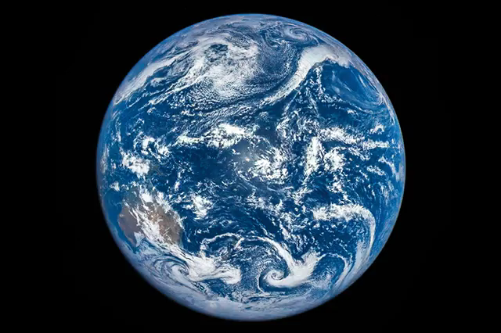

Slide 16
This means that although solar and lunar eclipses should both occur between 2-4 times per year, you are much more likely to see a lunar eclipse.
Everyone on the side of the Earth in darkness should be able to see a lunar eclipse, because the Earth's shadow covers the whole Moon. Only the people in the small area of Earth that the Moon's shadow covers will be able to see the solar eclipse.

